Slide 1
…
Data structure

Slide 2
Salespeople as decision-makers under uncertainty
?
?
?
?
?
?
?
?
?
?
Period 1
Period 2
Period 3
Etc.
Complex series of decision making/ judgment.
No idea what effect of updating is (happens between the dots) on conversion of a prospect.
Does updating interact with other prospects?
Lead Closed (Win/Lose)
Lead created (initial judgment)

Slide 3
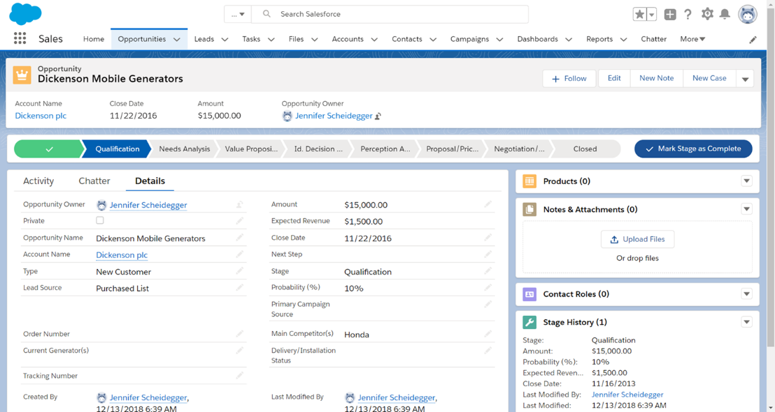
What information do sales reps have?

Slide 4
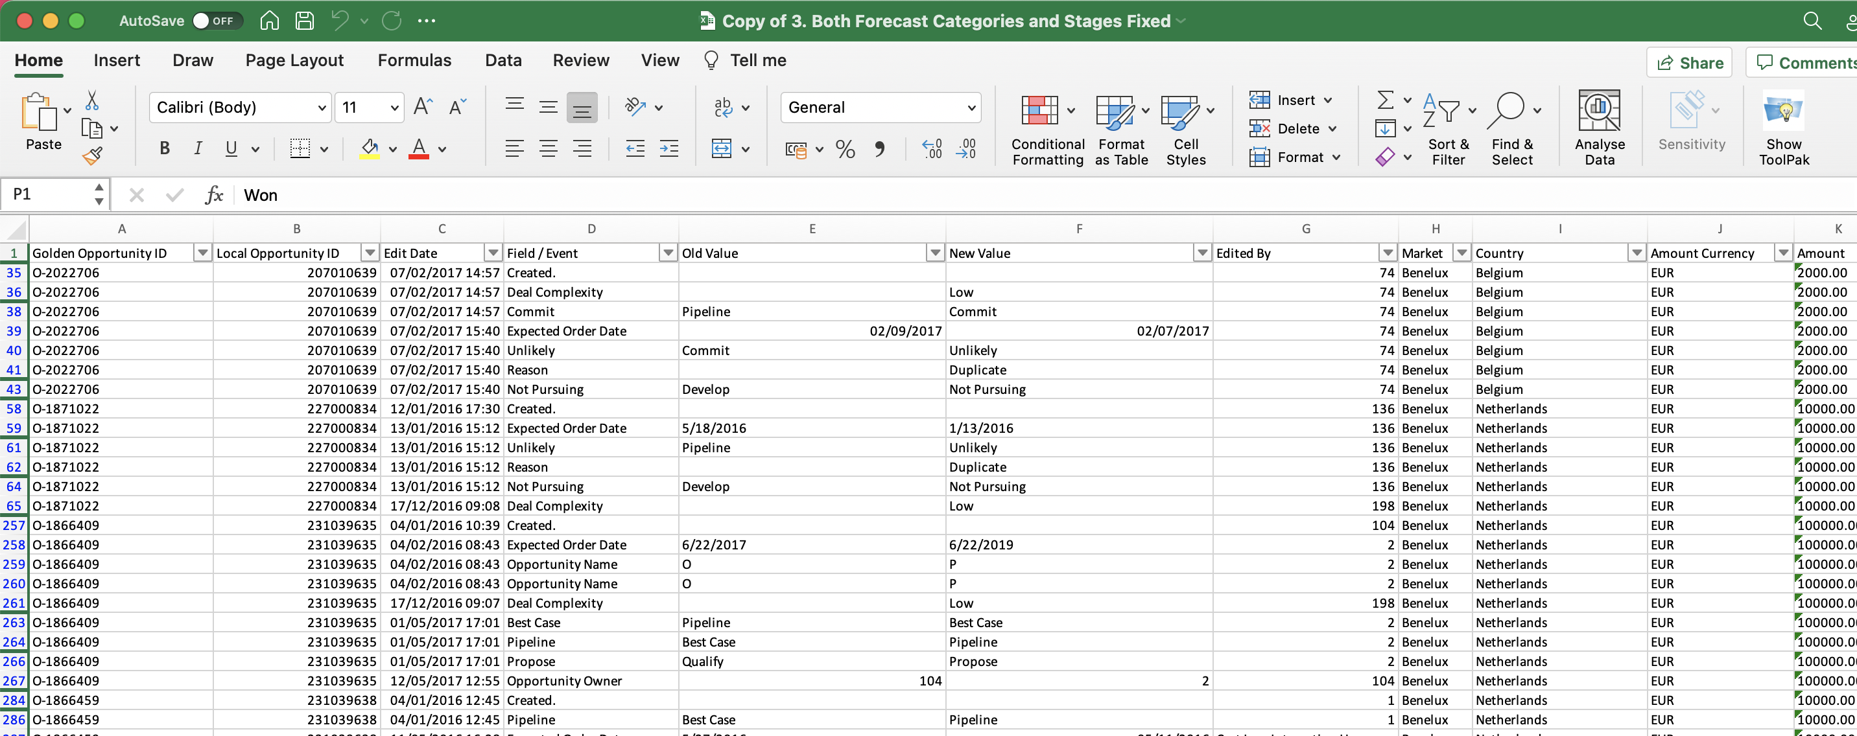
What information do we have?

Slide 5
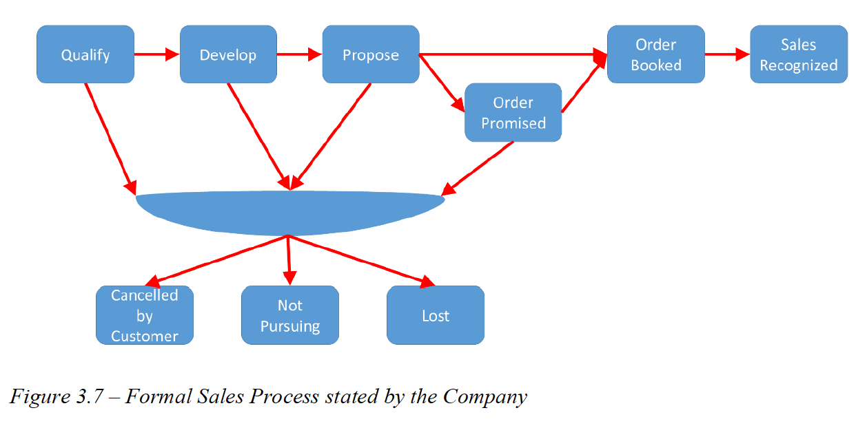
Fixed characteristics:
Product vs solutions
Customer (industry/ segment)
Variable characteristics:
Amount (magnitude)
Conversion uncertainty
Deal complexity
Expected Order Date
Lead owner (sales rep)
Notes:
At every stage SalesRep can update information about the lead.

Slide 6
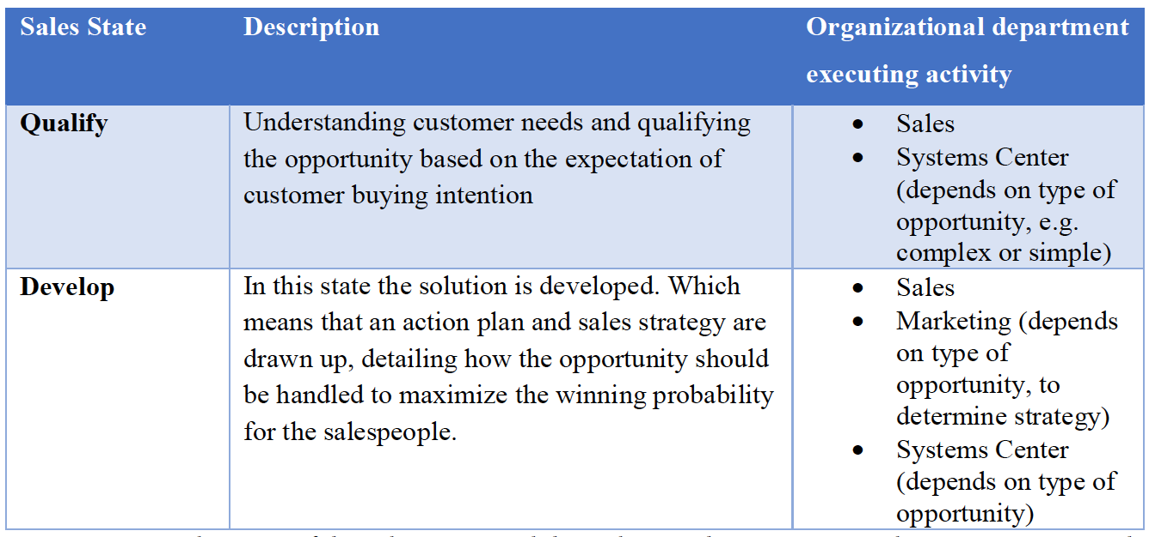
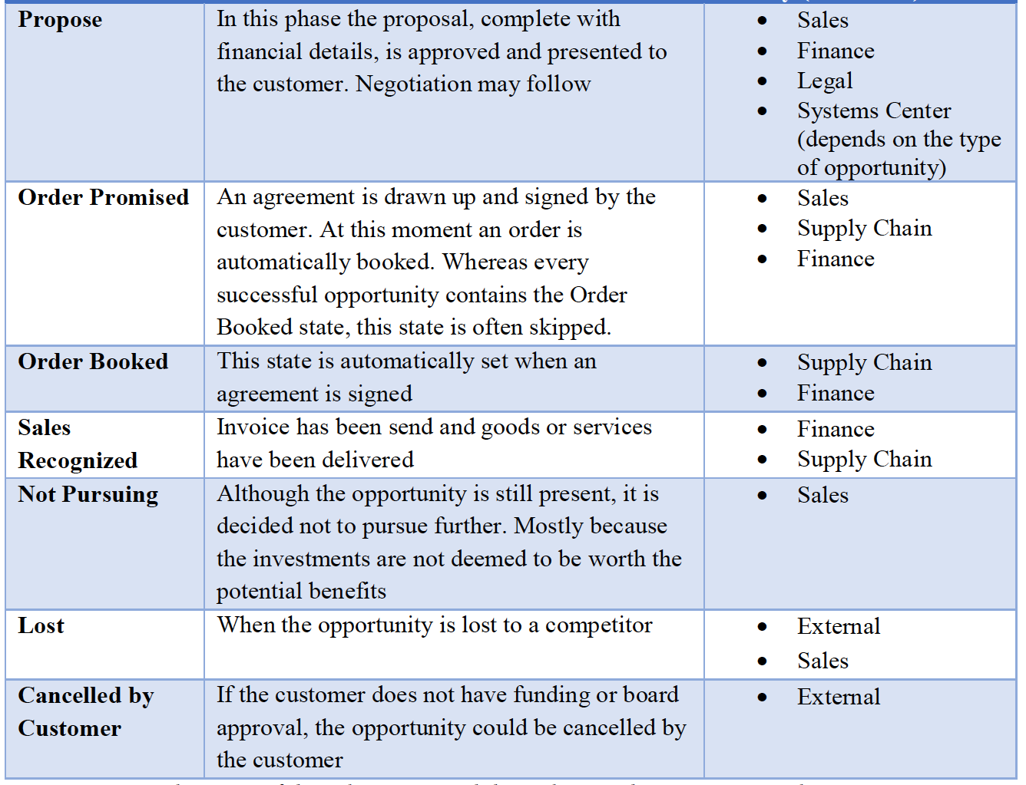

Slide 7
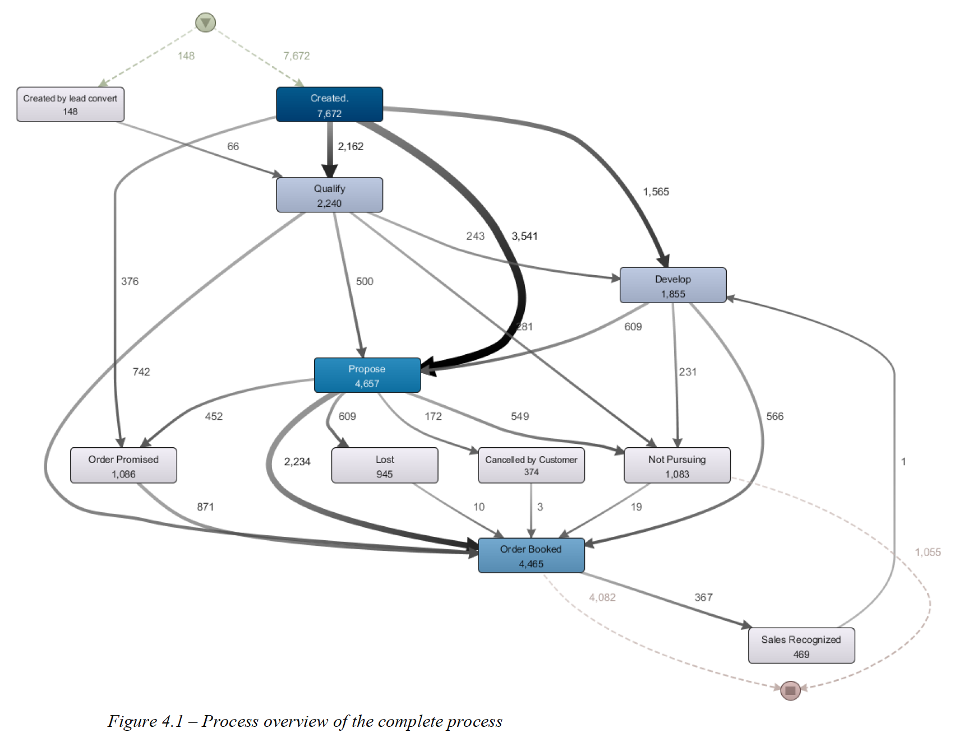

Slide 8
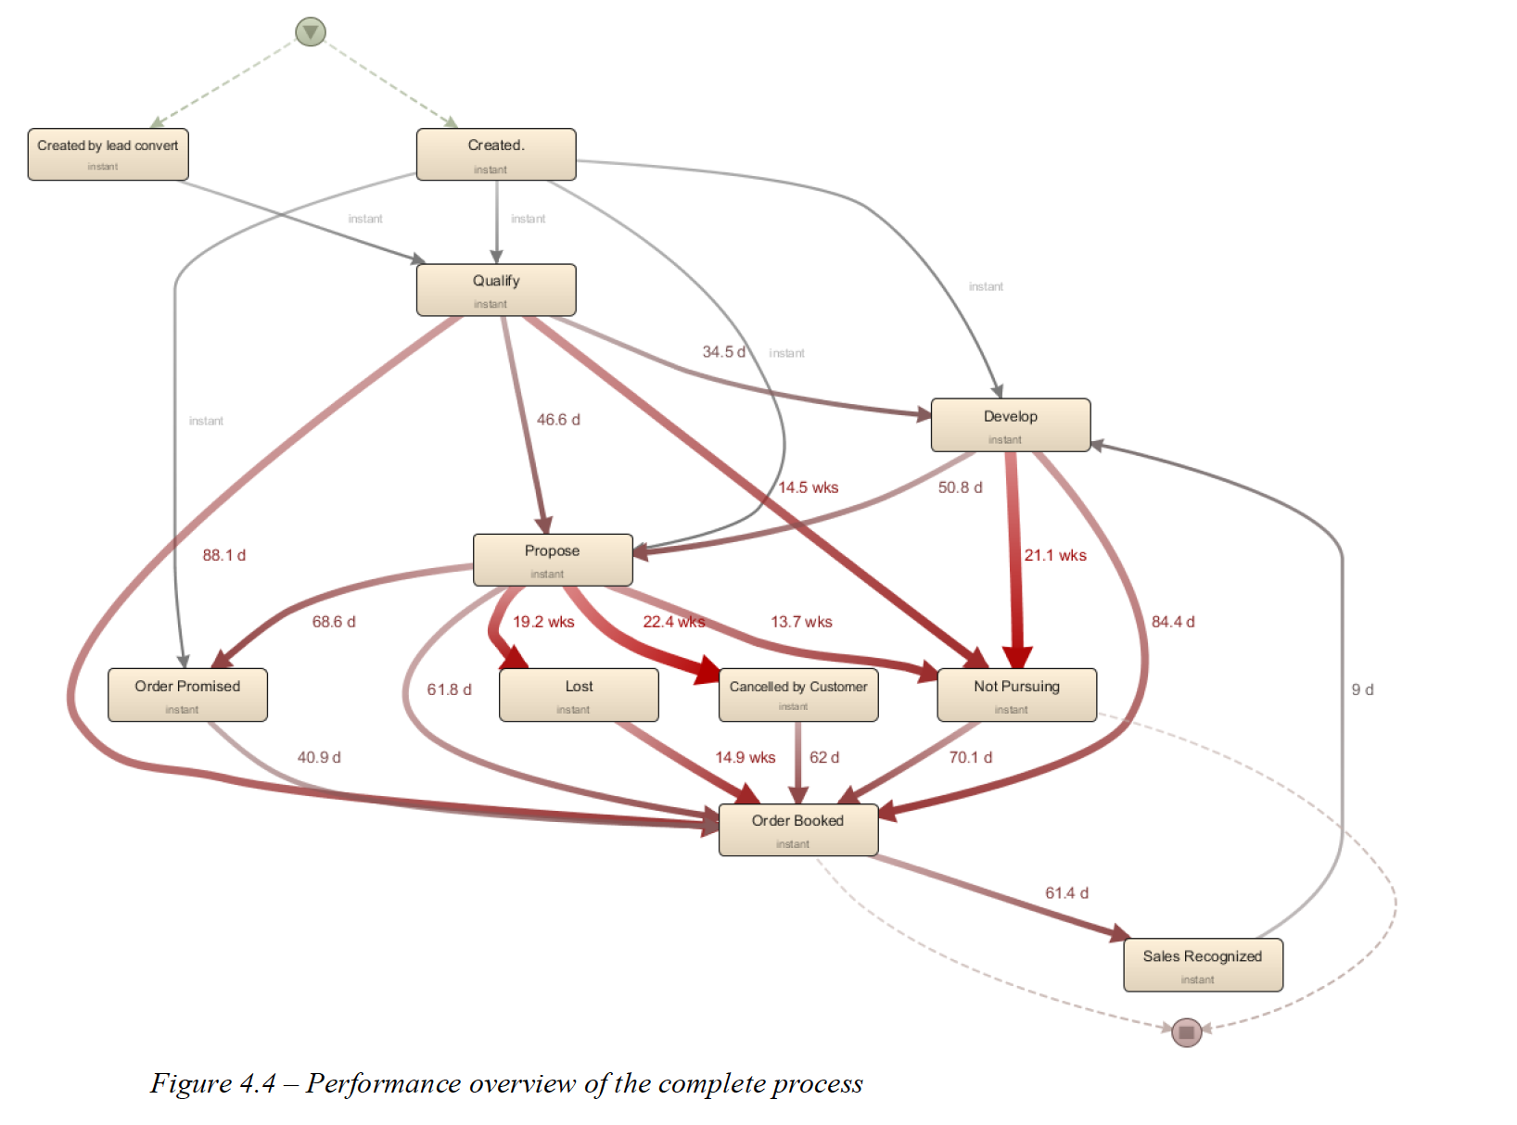

Slide 9
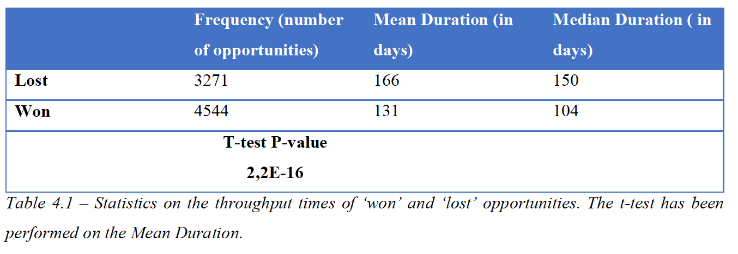

Slide 10
